Slide 1
Otto von bismarck Speech to the Reichstag
BY: Federico Reyes Gomez

Slide 2
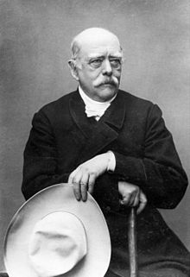
BISmarck
Otto Eduard Leopold
Prince of Bismarck
Duke of Lauenburg
1 April 1815 – 30 July 1898
Born in Schönhausen (Saxony)
Typical Prussian Junker
Very intelligent
Lutheran
University of Göttingen and Berlin
Diplomat, Officer

Slide 3
Political career
Vereinigter Landtag at age 32
Royalist and Reactionary
Divine right to rule
1848: Roused peasants to fight for King
Diet of the German Confederation
Ambassador to Russia under Wilhelm I
Detached from Germany but able to make connections in Russia, France, England

Slide 4
Unification?
1849: Rejected unification
Prussia would lose independence
Representative at Erfurt Parliament to oppose unification
Eight years in Diet of the German Confederation in Frankfurt
Developed ideas of unification
Developed relations with Russia and Napoleon
Leopold von Gerlach- “Foolish to play chess having first put 16 of the 64 squares out of bounds”

Slide 5
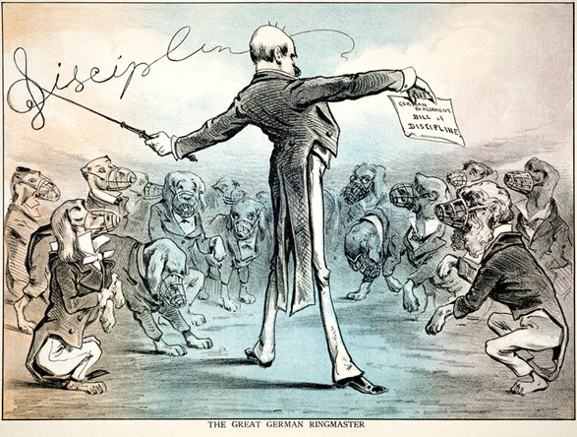
Minister president
Minister President and Foreign Minister in 1862
Unable to fund re-organization of army from Liberal Diet
Found a loophole in the constitution
Initially distrusted
Kept favor with
persuasion and threats of leaving

Slide 6
Eisen und Blut
“Prussia must concentrate and maintain its power for the favorable moment which has already slipped by several times. Prussia's boundaries according to the Vienna treaties are not favorable to a healthy state life. The great questions of the time will not be resolved by speeches and majority decisions—that was the great mistake of 1848 and 1849—but by iron and blood”
Didn’t believe in the “German Fatherland”
Main goal was to expand state

Slide 7
quotes
“The main thing is to make history, not to write it”
“All treaties between great states cease to be binding when they come in conflict with the struggle for existence”

Slide 8
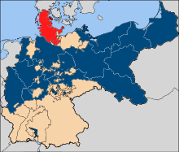
Seven weeks war
Prussia fought Denmark with Austria for Schelswig and Holstein
Isolated Austria from possible allies and attacked
Created N.G.C. and appeased socialists and liberals with Reichstag “democracy”

Slide 9
Franco-prussian war
Had met with Napoleon III and agreed to mutual expansion, good relations
France wanted war for public approval of Bonaparte name
To scare S. German states, Bismarck provoked war with isolated France
Spanish Succession
”Ems Dispatch”

Slide 10
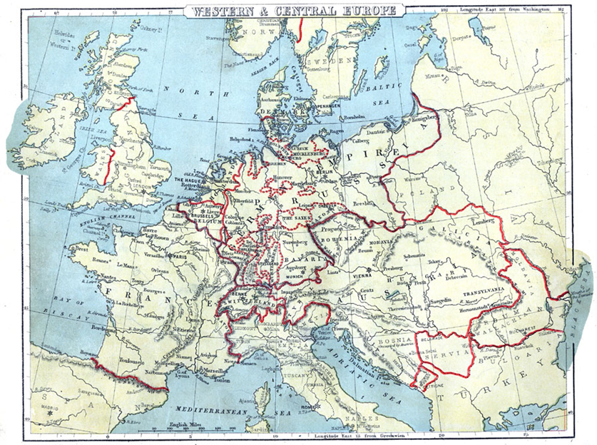
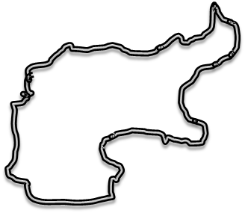

Slide 11
Speech to the reichstag (1888)
Asking the Reichstag for military funding
Germany needs to be protected in case of war
Heart of Europe, 3 fronts
Franco-Prussian Press - Carp between two Pike
If they are attacked, Germany will be victorious

Slide 12
Speech to the reichstag
“In such a one the whole of Germany from Memel to the Alpine Lakes will flare up like a powder mine; it will be bristling with guns, and no enemy will dare to engage this furor teutonicus which develops when we are attacked”

Slide 13
Speech to the reichstag
“I am, therefore, not in favor of any kind of aggressive war, and if war could result only from our attack- somebody must kindle a fire, we shall not kindle it”

Slide 14
Speech to the reichstag
“Attack the German nation anywhere, and you will find it armed to a man, and every man with the firm belief in his heart: God will be with us”

Slide 15
Discussion questions
Do you agree with Bismarck? Is blood and iron better than speeches and majority decisions? In what situation might one be better than the other?
Can you make any modern-day correlations with Bismarck’s realpolitik strategies?

